Slide 1
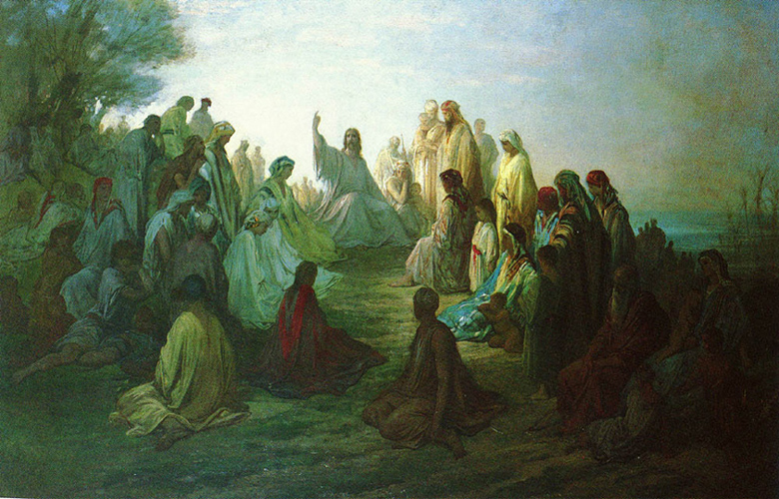
Beatitudes
Sermon on the Mount
Matthew 5: 1 - 12

Slide 2
Blessed are the poor in spirit, for theirs is the kingdom of heaven
Poor in spirit means:
Knowing that we need God in all things
Knowing that God is above all and that we are sinners
To be humble and not full of pride
Being meek – not trying to get one’s own way
Being gentle
Not boastful of your accomplishments or your talents

Slide 3
Blessed are those who mourn, for they shall be comforted
Mourning means:
Enduring or suffering through all the evil in the world
Regretting the sins we commit
Not wanting others to suffer
Consoling those going through a hard time
Allow someone their full range of emotions – they can be sad, happy, afraid, etc.

Slide 4
Blessed are the meek, for they shall inherit the earth.
Being meek means:
Doing the will of God
Self-control
Not reacting negatively in the face of adversity

Slide 5
Blessed are they who hunger and thirst for righteousness, for they shall be satisfied.
To hunger and thirst means:
To want justice
To try to live virtuously
To try to live a holy life

Slide 6
Blessed are the merciful, for they shall obtain mercy
To be merciful means:
To be loving towards others
To be forgiving (trespasses in “Our Father”)
Pray for others
Help the poor get the basic needs of life
Food, clothing, shelter
Visit a sick or elderly person

Slide 7
Blessed are the pure of heart, for they shall see God.
Being pure of heart means:
To not be self-seeking or full of selfish desires
To do something for another without hope for repayment
To want the best for others

Slide 8
Blessed are the peacemakers, for they shall be called children of God.
Peacemakers:
Try to bring about a just world
Speak to the one with no friends
Do God’s work

Slide 9
Blessed are they who are persecuted for the sake of righteousness, for theirs is the kingdom of heaven.
Those who are persecuted:
Continue to follow Christ/God even while being made fun of by others for:
going to Church,
wearing a cross,
being nice to others,
participating in social justice events etc.
Willing to die for their beliefs

Slide 10
Works cited Accessed Sept 13, 2011
“The Eight Beatitudes of Jesus.”
http://www.jesuschristsavior.net/Beatitudes.html
“The Eight Beatitudes of Jesus.” New Ad vent Catholic Encyclopedia
http:// www.newadvent.org/cathen/02371a.htm
“Beatitudes--Their Significance And Meaning” bob wells
http://robertwells.tripod.com/Beatitudes.html

