Slide 1
Israel

Slide 2
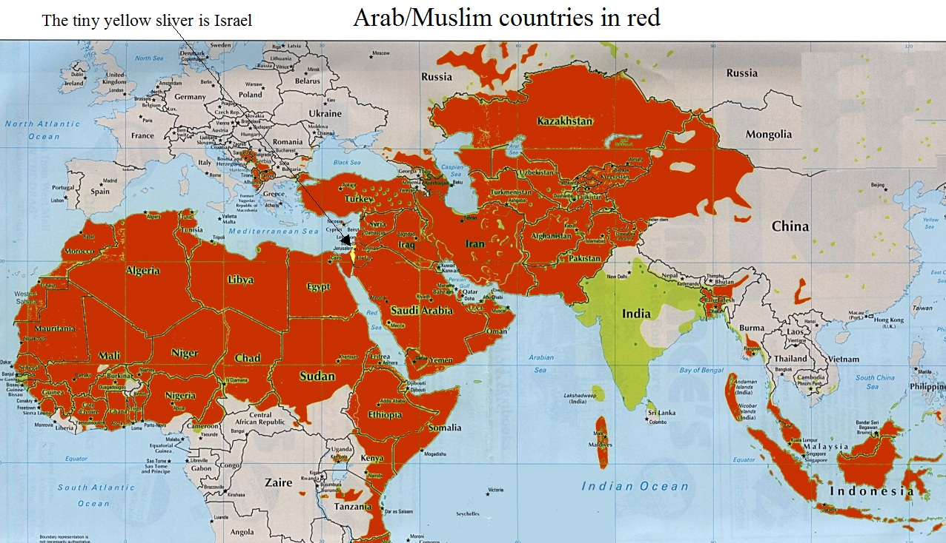

Slide 3
Previous map url
http://edgar1981.blogspot.ca/2014/05/countering-shrinking-palestine-maps-lie.html

Slide 4
Changing borders of Israel

Slide 5
The Green Line
The Green Line is a term originally used to define Israel’s borders with Jordan from the period following Israel’s 1948 Independence War until the 1967 Six Day War when Israel captured the West Bank and East Jerusalem. It was named for the green marker used by Israeli and Jordanian officers negotiating an armistice in 1949 to delineate the borders between the two countries.
Today, the term is used to demarcate the “pre 1967” border (with the West Bank and East Jerusalem outside of Israel), and the “post 1967” borders. During the past two decades of peace talks between Israel and the Palestinians, the Green Line has become the generally-accepted land marker used in land-for-peace negotiations.

Slide 6
The Palestinians – whose population over the Green Line is estimated at over 2.5 million – believe all areas over the green line should be part of their future state.
While Israel maintains that the old 1949 Green Line borders are indefensible - at its narrowest point from the Mediterranean coast to the demarcation line, Israel is only about nine miles wide – it has also proposed land swaps of small areas of Israeli territory within the Green Line in exchange for incorporating into Israel similar areas over the Green Line with large Israeli populations. Israel has repeatedly offered as much as 95%of the West Bank for a Palestinian state in exchange for peace (see Camp David 2000). Israel has also reportedly offered Palestinian leadership the option of establishing the capital of a future state in East Jerusalem, a move that is considered controversial by many within Israel.
http://www.adl.org/israel-international/israel-middle-east/content/AG/the-green-line.html#.WD8LZeYrLIU

Slide 7
Extra Maps for Islamic countries:
Maps for Islamic countries:
On Wikipedia:
https://upload.wikimedia.org/wikipedia/en/e/e4/Muslim_Percent_Population_v2.svg
world map – Muslim distribution
http://www.islam101.com/dawah/muslim_world_map.html
Religions of the world
http://www.mapsofworld.com/world-religion-map.htm

