Slide 1
D.B. Cooper
True life crime story
Page 120

Slide 2
Before reading
Is there such thing as the perfect crime?
What would such a crime entail?

Slide 3
Before reading continued
What is hijacking?
What are the usual motives for it?
What are the punishments or
consequences for hijacking?

Slide 4
Definition
hi·jack
ˈhīˌjak/ verb
gerund or present participle: hijacking
illegally seize (an aircraft, ship, or vehicle) in transit and force it to go to a different destination or use it for one's own purposes.

Slide 5
Motives
Tactical and psychological
Includes hostage taking often
http://www.trackingterrorism.org/article/hijacking-terrorist-tactic
Media coverage
copy cat – 15 minutes of fame
Mental illness
Goal seeking – ways to get what they cannot usually access and to solve their problem
http://pegasus.cc.ucf.edu/~surette/hijacking.html

Slide 6
Motives continued
psychopathic extremists
– could not live up to expectations of their father
- lost their father
- lost their job
- broke up with girlfriend
Need to conform to cultural or religious pressures
Suicidal
http://www.tuscaloosanews.com/article/20110910/NEWS/110909725

Slide 7
Punishments/Consequences
By International Law through United Nations signed by 50 countries
Extradition
Sanctions against countries that harbour the hijackers including not being able to land planes in other countries
http://www.britannica.com/topic/hijacking
Death penalty in India and United States
https://books.google.ca/books?id=DXpzAQAAQBAJ&pg=PA140&lpg=PA140&dq=hi-+jacking+punishments&source=bl&ots=kbR16_MF-t&sig=Gz7VgWea4hcMicdybC2pcA_0260&hl=en&sa=X&ved=0CE8Q6AEwCGoVChMI3qmJ7efoxwIVxNceCh3SGQAV#v=onepage&q=hi-%20jacking%20punishments&f=false
http://www.dnaindia.com/india/report-govt-okays-changes-to-anti-hijacking-law-introduces-harsher-punishment-2109365

Slide 8
Read the story aloud up to the statement “Do whatever he demands.” page 121
Why would such a decision be made?
Do you agree that a hijacker should get whatever he asks for?
a. What do you think will happen next?
b. Write down your predictions for
the rest of the story.

Slide 9
Read the rest of the story.
Discuss your predictions.

Slide 10
Answer:
Did D.B. Commit the perfect crime? Explain.
Also, do you think he escaped with the money?
Why does Ariel, Washington celebrate his crime?
4. Define the following terms:
a. subterfuge,
b. tarnation,
c. diabolical,
d. folk hero

Slide 11
Identify elements of confusion or of questions in the story.
Identify the following elements in this
story:
a. plot
b. characters
c. atmosphere
d. setting
e. conflict

Slide 12
Folk heroes
What do you know about social outlaws like Robin Hood, Jesse James, Butch Cassidy, Pretty Boy Floyd, and Bonnie and Clyde?
Why did they become popular folk heroes?

Slide 13
ROBIN HOOD
Robin Hood was a heroic outlaw in English folklore. A highly skilled archer and swordsman, he is known for "robbing from the rich and giving to the poor",^{[1]} assisted by a group of fellow outlaws known as his "Merry Men".^{[2]} Traditionally, Robin Hood and his men are depicted wearing Lincoln green clothes.^{[3]} The origin of the legend is claimed by some to have stemmed from actual outlaws, or from ballads or tales of outlaws.^{[4]}
Robin Hood became a popular folk figure in the medieval period continuing through to modern literature, films and television. In the earliest sources, Robin Hood is a yeoman, but he was often later portrayed as an aristocrat wrongfully dispossessed of his lands and made into an outlaw by an unscrupulous sheriff.^{[5]}

Slide 14
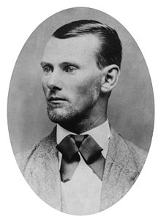
Jesse James
Jesse Woodson James (September 5, 1847 – April 3, 1882) was an American outlaw, gang leader, bank robber, train robber, and murderer from the state of Missouri and the most famous member of the James-Younger Gang. Already a celebrity when he was alive, he became a legendary figure of the Wild West after his death. Some recent scholars place him in the context of regional insurgencies of ex-Confederates following the American Civil War rather than a manifestation of frontier lawlessness or alleged economic justice.^{[1]}
Jesse and his brother Frank James were Confederate guerrillas during the Civil War. They were accused of participating in atrocities committed against Union soldiers. After the war, as members of one gang or another, they robbed banks, stagecoaches and trains. Despite popular portrayals of James as a kind of Robin Hood, robbing from the rich and giving to the poor, there is no evidence that he and his gang used their robbery gains for anyone but themselves.^{[2]}
The James brothers were most active with their gang from about 1866 until 1876, when their attempted robbery of a bank in Northfield, Minnesota, resulted in the capture or deaths of several members. They continued in crime for several years, recruiting new members, but were under increasing pressure from law enforcement. On April 3, 1882, Jesse James was killed by Robert Ford, who was a member of the gang living in the James house and who was hoping to collect a state reward on James' head

Slide 15
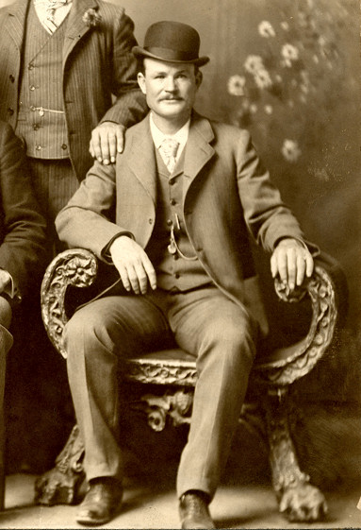
Butch Cassidy
Robert LeRoy Parker (April 13, 1866 – November 3, 1908), better known as Butch Cassidy,^{[1]} was a notorious American train robber, bank robber, and leader of the Wild Bunch Gang in the American Old West. After pursuing a career in crime for several years in the United States, the pressures of being pursued, notably by the Pinkerton Detective Agency, forced him to flee with an accomplice, Harry Alonzo Longabaugh, known as the Sundance Kid, and Longabaugh's girlfriend, Etta Place, first to Argentina and then to Bolivia, where he and Longabaugh were allegedly killed in a shootout in November 1908.

Slide 16
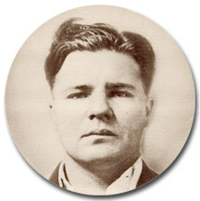
Pretty Boy Floyd
Charles Arthur "Pretty Boy" Floyd (February 3, 1904 – October 22, 1934) was an American bank robber. He operated in the Midwest and West South Central States, and his criminal exploits gained heavy press coverage in the 1930s. Like most other prominent outlaws of that era, he was killed by policemen. He remains a familiar figure in American popular culture, sometimes seen as notorious, but at other times viewed as a tragic figure, partly a victim of hard times

Slide 17
Bonnie and Clyde
Bonnie Elizabeth Parker (October 1, 1910 – May 23, 1934) and Clyde Chestnut Barrow (March 24, 1909 – May 23, 1934) were well-known outlaws, robbers, and criminals who traveled the Central United States with their gang during the Great Depression. Their gang was known as the "Barrow Gang" which included Bonnie and Clyde, and at times Buck Barrow, Blanche Barrow, Raymond Hamilton, W.D. Jones, Joe Palmer, Ralph Fults, and Henry Methvin. Their exploits captured the attention of the American public during the "public enemy era" between 1931 and 1934. Though known today for his dozen-or-so bank robberies, Barrow in fact preferred to rob small stores or rural gas stations. The gang is believed to have killed at least nine police officers and committed several civilian murders. The couple themselves were eventually ambushed and killed in Louisiana by law officers. Their reputation was cemented in American pop folklore by Arthur Penn's 1967 film Bonnie and Clyde.^{[1]}

Slide 18
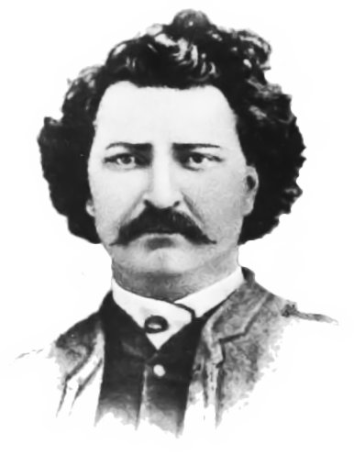
Louis Riel
On today's date 125 years ago -- November 16, 1885 -- Louis Riel was hanged in Regina, Saskatchewan after being convicted of treason. On behalf of his dispossessed and beleaguered Métis people, he led the unsuccessful North-West Rebellion against the Canadian government. Most English Canadians supported his execution and most French Canadians opposed it. His death continues to be controversial in Canada, even after all these years.
Posted Nov 16, 2010

Slide 19
Definition of folk hero
A folk hero is a type of hero who gains this status based on personal achievement or some action which is recognized by others as revolutionary. While most of the characteristics of folk heroes varies from hero to hero, there are a few which are unanimous and crucial to the definition of the folk hero. Otherwise, much of what defines the folk hero has to do with his or her personal feats.

Slide 20
What Are the Characteristics of a Folk Hero?
By Kathryn Stanley, eHow Contributor
Kathryn Stanley is a professional writer for various websites, covering fashion, science, the environment, food and baking, crafts and the arts. She studies psychology and creative writing at the University of
Maryland at College Park.

Slide 21
Widespread Society Recognition
There is only one truly crucial component in defining the folk hero, and that has to do with widespread recognition of the person as being heroic. Many people commit acts of kindness or generosity but that alone does not make them a folk hero. When society is able to recognize an important figure by their name, personality, or deeds, then this person has achieved the status of folk hero.

Slide 22
Exaggerated Nature of Character
Folk heroes, as long as they have the one aforementioned crucial characteristic, can vary in a few ways. Folk heroes may be real or based on mythology. In some cases, folk heroes may be historical figures. In essentially all cases, though, the nature of the character is exaggerated for the sake of the story. For example, a folk hero might be described as not needing to sleep. Both physical and personality traits are dramatized. Much of what defines a folk hero is the elusive nature of the character. This elusive nature stems from the exaggerated emphasis placed on the character's physical and character strengths and weaknesses.

Slide 23
Personality
There are a few common personality traits of a folk hero. Folk heroes tend to be brave and willing to face opposition. Given the exaggerated nature of the folk hero's character, there is strong emphasis placed on these traits in the accompanying stories. Also, because the folk hero does not usually start out as such, but rather gains his status as a folk hero with his motivation, traits such as bravery and motivation to seek change are given a lot of weight and end up defining the folk hero.

Slide 24
Leadership and Protection
The folk hero commonly takes on a role of leadership and protection. In traditional folk hero stories, the common people of society are facing an instance of injustice or corruption. One person ends up being the force to stand up to the oppression and create the change that the people want. This person ends up being defined as a folk hero, because he or she takes on the leadership role necessary to facilitate societal change. This individual is then seen as a protector in the community, giving the individual the status of folk hero.

Slide 25
Read more: What Are the Characteristics of a Folk Hero? | eHow.com http://www.ehow.com/info_8633051_characteristics-folk-hero.html#ixzz25BhktVd9

Slide 26
Does D.B. Cooper fit into the category of folk hero? Why or why not?

Slide 27
Evidence to support an Opinion
Create a list of specific references from the text to show that Cooper was intelligent and well organized.
Share your list with 2 other students.

Slide 28
Assignment
Crimes happen for many reasons. A dilemma is one reason. A dilemma is defined as “ A situation that requires a choice between equally unfavorable or mutually exclusive options.” Every so often, individuals facing a dilemma make the wrong choice, and a law is broken.

Slide 29
In the 1960s a theorist named Lawrence Kohlberg under took investigations of this sort of situation. His approach was to describe situations in which a person is faced with having to make a choice where the choice is a moral dilemma.
Read the dilemma and answer the questions honestly as you believe they should be answered.

Slide 30
Kohlberg dilemma questions and discussion

Slide 31
Who was D.B. Cooper?
Investigate the following sites on the
internet to answer the question above. The
addresses are on the printed handout.
A. Super70s.com
B. who2 biographies
C. US News
D. Daily Mail
You do not have to write anything for
question 1. Just read and then answer the following questions.

Slide 32
What is your impression of these
articles?
Do you believe that the case is solved?
Why or why not?
How accurate was Max Haines’ presentation of the facts? Give specific examples to support your answer.

