Slide 1
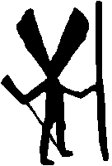
Nanabush
Nanabozho

Slide 2
In Anishinaabe mythology, particularly among the Ojibwa, Nanabozho also known as Nanabush is a spirit, and figures prominently in their storytelling, including the story of the world's creation. Nanabozho is the Ojibwe trickster figure and culture hero (these two archetypes are often combined into a single figure in First Nations mythologies).

Slide 3
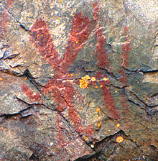
Pictograph
of Nanabozho
on Mazinaw Rock,
Bon Echo Provincial Park, Ontario

Slide 4
Stories
Nanabozho was one of four sons of Wiininwaa ("Nourishment"), a human mother, and E-bangishimog ("In the West"), a spirit father.
Nanabozho most often appears in the shape of a rabbit and is characterized as a trickster. In his rabbit form, he is called Mishaabooz ("Great rabbit" or "Hare") or Chi-waabooz ("Big rabbit"). He was sent to Earth by Gitchi Manitou to teach the Ojibwe. One of his first tasks was to name all the plants and animals. Nanabozho is considered to be the founder of Midewiwin. Like the Egyptian god Thoth, he is thought to be the inventor of fishing and hieroglyphs. This deity is a shape-shifter and a cocreator of the world.
In more recent myths among the Ojibwe, Nanabozho saves the forests from Paul Bunyan. They fought for forty days and nights, and Nanabozho killed Bunyan with a Red Lake walleye.
wikipedia

Slide 5
What is a shape shifter?

Slide 6
one that seems able to change form or identity at will; especially: a mythical figure that can assume different forms (as of animals)
http://www.merriam-webster.com/

Slide 7
In traditional mythology and folklore, and in modern fantasy fiction, shapeshifting is the ability of a being to physically transform into another form or being, either as an inherent faculty of a mythological creature, or by means of magic.
wikipedia

Slide 8
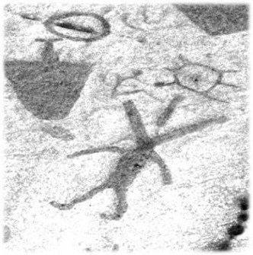
Nanabozo (Nanabozho or Nanabush) is a
mythological culture hero found in the
cosmological traditions of the Algonquian
tribes of central and eastern Canada.
Nanabozo is the impersonation of life, with
the power to create life in others. His
gender is undefined and changeable. She also appears as diverse personalities and forms - including a raven, a coyote, a hare - which represent the various phases and conditions of the life cycle. In some myths Nanabozo creates animals and causes plants and roots to grow so men can eat. He also features in many comic, bawdy tales that emphasize his immense earthly appetites for food and sex. She plays a dual role in mythology, both as benefactor to the native people and as a prankish and obscene fool. He is both a powerful creator, and a ridiculous clown.
Nanabush Depiction of Nanabozo (Nanabush) from the Peterborough Pictograph Site in Southern Ontario (courtesy Serge Lemaître).

Slide 9
Nanabozo, also known as the Trickster, appears as a character in a number of late 20th-century literary works. He is the main character in Thomas KING's short story "The One About Coyote Going West" and also appears as a coyote in King's novel Green Grass Running Water. Nanabush is a seagull, a nighthawk, and a bingo master in Tomson HIGHWAY's play The Rez Sisters. In the foreword to this play, Highway describes Nanabush as being "as pivotal and important a figure in the Native world as Christ is in the realm of Christian mythology."
Author RENÉ R. GADACZ
The Canadian Encyclopedia © 2012 Historica-Dominion
http://www.thecanadianencyclopedia.com/articles/nanabozo

Slide 10
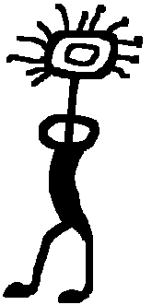
THE ORIGINS OF NANABUSH
In the beginning, as the Ojibwa story tellers say, the world in which we live did not exist. Kitchi Manitou, the Great Spirit, had a dream in which he saw a world made of mountains and valleys, lakes and streams, plants and animals, and people. In his wisdom Kitchi Manitou realized that he was to bring these things into being. He created a world made of four primary elements; rock, water, fire and wind:
To the sun he gave the power to heat and light the earth, To the earth he gave the power of growth and healing, To the water he gave purity and renewal, To the wind he gave music and the breath of life itself, After these things Kitchi Manitou created human kind.
To them he gave the power of dream.
 | Gitchi Manitou or the Great Spirit. The creator of the world. The sun is said to be his home.

Slide 11
As the world was new, the Ojibwa people had
much to learn and Kitchi Manitou took pity on
them and sent them a teacher, Nanabush.
Nanabush was the son of a human mother and
the West Wind spirit father. He was sent to earth to teach his people about the healing plants, about kindness, generosity, and honesty. One of Nanabush's first tasks was to name the trees, the waters, the mountains, the animals, the birds and the plants.
Nanabush had powerful magic to give special powers or attributes to the animals and plants. Nanabush was also a Trickster, bent on making humans look silly (although his own jokes often backfired on him). As a Trickster, he could change form and take the shape of an animal. The one distinguishing feature of Nanabush when he was in human form, as drawn on rocks and carved in stone by the Ojibwa, was his rabbit-like ears.
http://www.geocities.com/yosemite/gorge/1066/513ojibwa.htm

Slide 12
SPIRITUAL LAWS
Be in good relationship with all things Children are a gift from the creator, lent to us for a short time How we honour a gift is one measure of how we honour that which created all things Beginnings and endings are the same; always and forever The Spirit of the Creator dwells in all things, both animate and inanimate Knowledge is to be shared. Each person is blessed by both the opportunity to teach and to learn, to give and to receive Knowledge once shared, is the greatest equalizer There is no forward growth free of the risk of pain, for pain is the balance of joy. Each heightens our understandings and appreciation for the other Truth is found in more than one direction; it is unchanging and forever Children are closer to the Creator. We are to learn from them, as much as they are to learn from us Nothing exists is owned by us. What we use we must share All things work in cycles or circles. We are related to everything that exists. As such, we must respect all of creation as much as we seek our own self-respect Of all the strengths, the greatest is kindness
Anishnabe 101: The Circle of the Turtle Lodge, Aimee Bailey, 2000

